Slide 1
Theory of Automata
Lecture #17-18-19

Slide 2
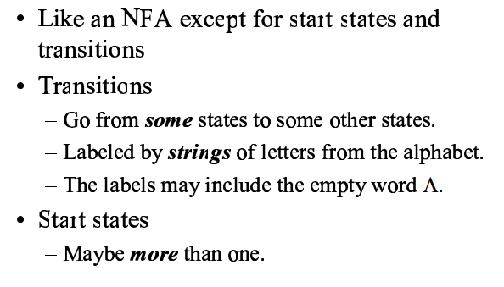
Transition Graph (T.G)

Slide 3
Transition Graph (T.G)
A finite set of states at least one of which is designated as the start state (-) and some (maybe none) of which are designated as final states (+).
An alphabet Σ of possible input letters from which input strings are formed.
A finite set of transitions that show how to go from one state to another based on reading specified substrings of input letters (possibly even the null string λ ).

Slide 4
Transition Graph (T.G)
A successful path through a transition graph is a series of edges forming a path beginning at some start state (there may be several) and ending at a final state. If we concatenate in order the strings of letters that label each edge in the path, we produce a word that is accepted by this machine.

Slide 5
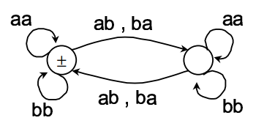
Transition Graph (T.G)-Even Even

Slide 6
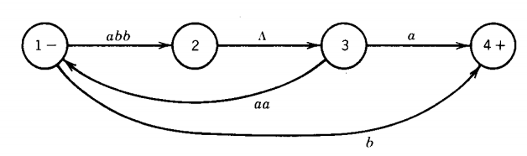
Transition Graph (T.G)
For example, consider the following TG
Some accepted words are abba, abbaaabba, and b etc

Slide 7
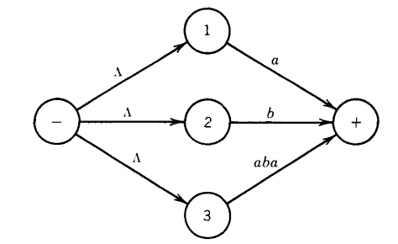
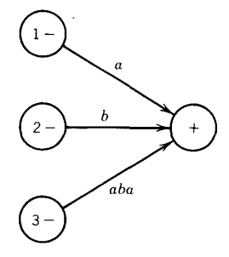
Transition Graph (T.G)
Both are Same

Slide 8
Transition Graph (T.G)
It is extremely important for us to understand that every FA is also a TG.
This means that any picture that represents an FA can be interpreted as a picture of a TG. Of course, not every TG satisfies the definition of an FA.
Let us consider some more examples of TG's.

Slide 9


Transition Graph (T.G)
The picture above represents a TG that accepts nothing, not even the null string A. To be able to accept anything, it must have a final state.
The machine
accepts only the string λ

Slide 10
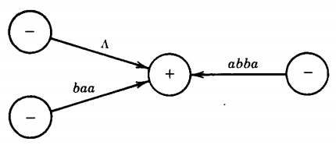
Transition Graph (T.G)
Any TG in which some start state is also a final state will always accept the string λ; this is also true of FA's
There are some other TG's that accept the word λ, for example:
This machine accepts only the words A, baa, and abba. Anything read while in the + state will cause a crash, since the + state has no outgoing edges

Slide 11
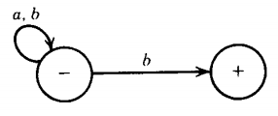
Transition Graph (T.G)
We can read all the input letters one at a time and stay in the left-side state. When we read a b in the - state there are two possible edges we can follow. If the very last letter is a b, we can use it to go to the + state

Slide 12
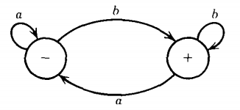
Transition Graph (T.G)
The language accepted by this TG is all words ending in b. One regular expression for this language is (a + b)*b and an FA that accepts the same language is

Slide 13
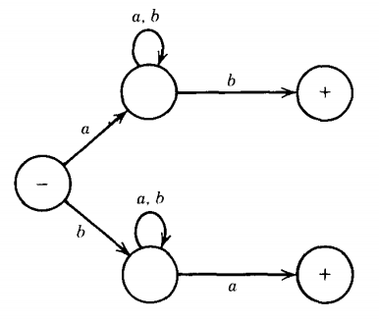
Transition Graph (T.G)
A TG
accepts the language of all words that begin and end with different letters

Slide 14
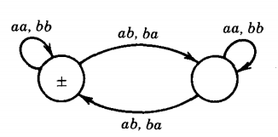
Transition Graph (T.G)
Consider the following TG:
in this TG every edge is labeled with a pair of letters. This means that for the string to be accepted it must have an even number of letters that are read in and processed in groups of two's.

Slide 15
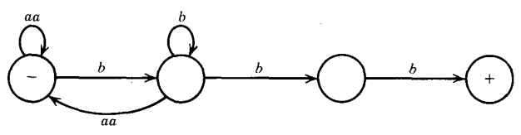
Transition Graph (T.G)
accepts the language of all words in which the a's occur only in even clumps and that end in three or more b's.

Slide 16
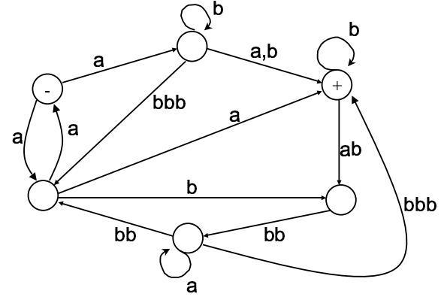
Transition Graph (T.G)-Even Even
is abbbabbbabba is accepted?

Slide 17
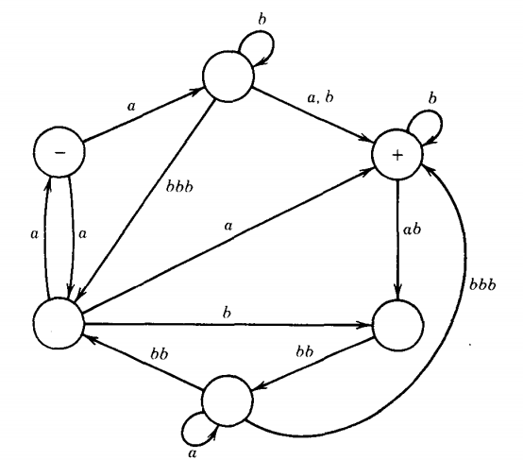
Transition Graph (T.G)
Consider this TG

Slide 18
Generalized Transition Graph(GTG)
Its is similar to transition graph except for transitions
Transitions
Goto from some states to some other states
Labeled by regular expressions formed from letters from the alphabets

Slide 19
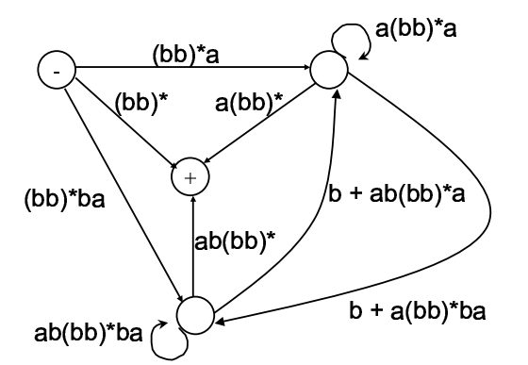
Generalized Transition Graph(GTG)

Slide 20
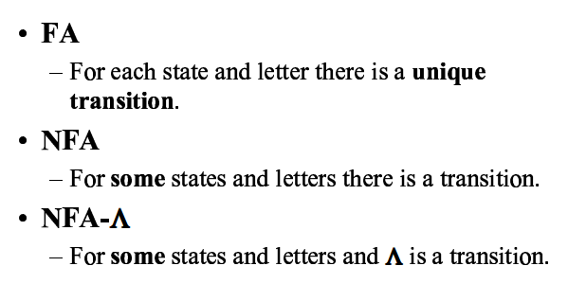
Types of Automata
Notes:
NFA with e moves or empty moves
Nondeterministic finite automaton with ε-moves(NFA-ε): This automaton replaces the transition function with the one that allows the empty string ε as a possible input, so the transition function is defined as Δ

Slide 21
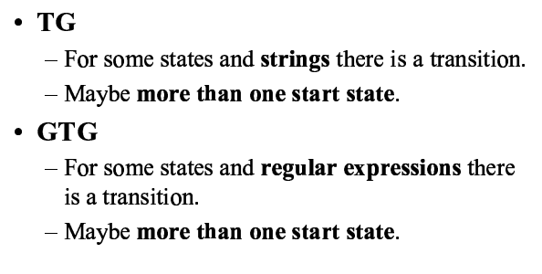
Types of Transition Graphs

Slide 22
Assignment
Solve question # 4 of book on page 103

Slide 23
Kleene Theorem-PART-I
Part I: Every FA is a TG
FA | TG
Single Start State and multiple end states | Multiple Start States and multiple end states
Finite set of input symbols | Same
Finite set of transitions | Same
Deterministic | Non-Deterministic
Distinguishing Rule | No such rule
Notes:
rule/path

Slide 24
Kleene Theorem-PART-II
Part I: Every language that can be defined by a finite automaton can also be defined by a transition graph. (Every FA is a TG)
This is the easiest part.
Every finite automaton is itself a transition graph.
Therefore, any language that has been defined by a finite automaton has already been defined by a transition graph.
Done
Notes:
rule/path

Slide 25
Kleene Theorem-PART-II
Part II : Every language that can be defined by a transition graph can also be defined by a regular expression
The prove of this Part requires a systematic algorithm through which a TG can be converted to a GTG, in which all transitions are actually regular expressions. Thus, we need to transform a TG to a GTG and eliminate its various states and convert it to a single state or single transition GTG, so that we can get the regular expression associated with the TG.
Steps involved in TG to GTG conversion Examples taken from Daniel I Cohen Book
Notes:
rule/path

Slide 26
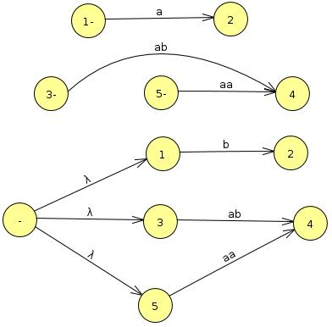
Kleene Theorem-PART-II
Step I: More than one Initial states conversion:

Slide 27
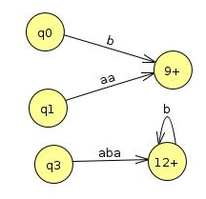
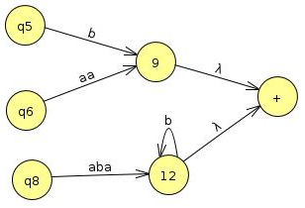
Kleene Theorem-PART-II
Step II: More than one Final states conversion:

Slide 28
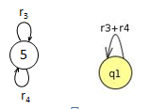
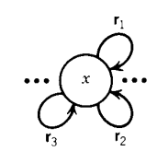
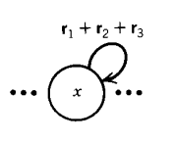
Kleene Theorem-PART-II
Step III: Multiple Loops conversion:

Slide 29
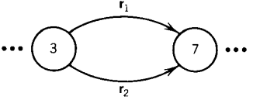

Kleene Theorem-PART-II
Step 4: State Merging
(Alternative)

Slide 30


Kleene Theorem-PART-II
State Merging
(Concatenation)

Slide 31
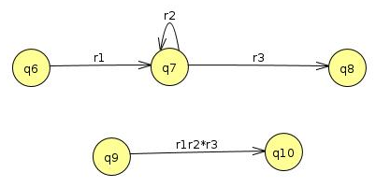
Kleene Theorem-PART-II
State Merging
(Remove self state Loops)

Slide 32
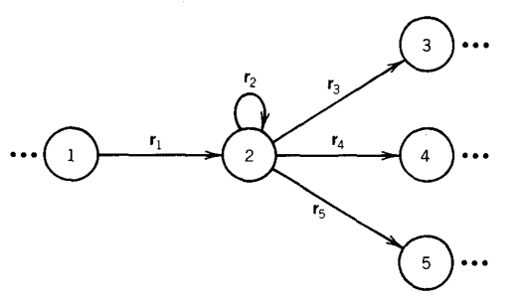
Kleene Theorem-PART-II
State Merging

Slide 33
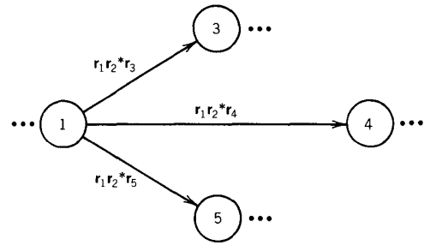
Kleene Theorem-PART-II
State Merging

Slide 34
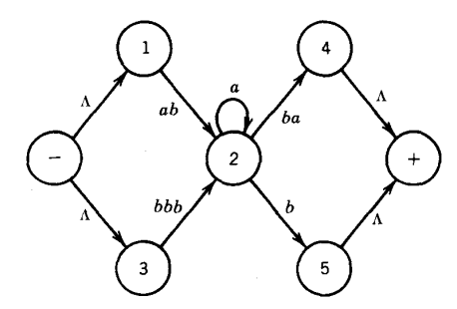
State elimination in Kleene Theorem

Slide 35
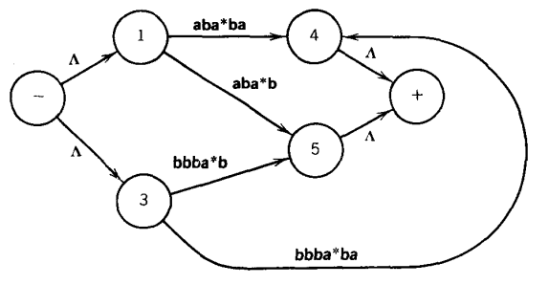
State elimination in Kleene Theorem

Slide 36
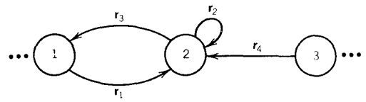
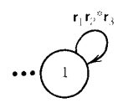
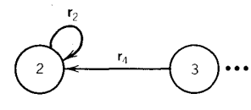
State elimination in Kleene Theorem

Slide 37
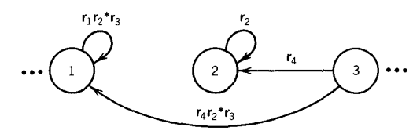
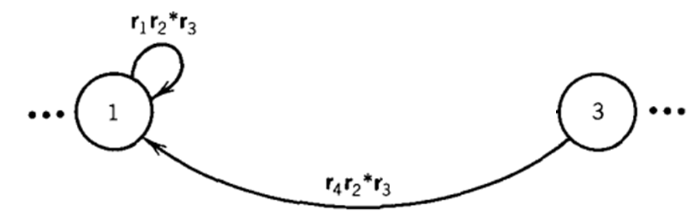
State elimination in Kleene Theorem

Slide 38
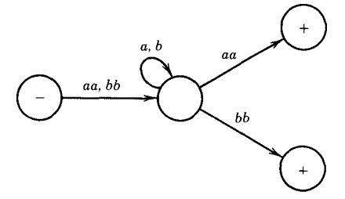
State elimination in Kleene Theorem

Slide 39
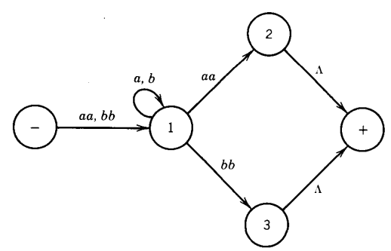
State elimination in Kleene Theorem

Slide 40
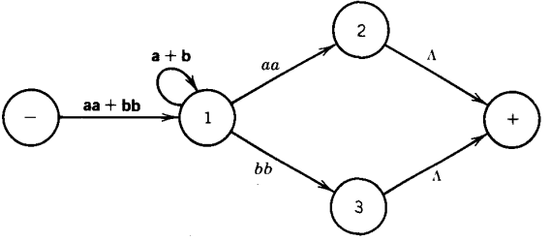
State elimination in Kleene Theorem

Slide 41
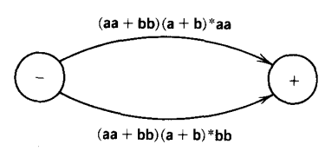
State elimination in Kleene Theorem

